Slide 1
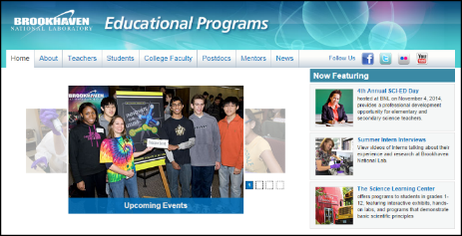
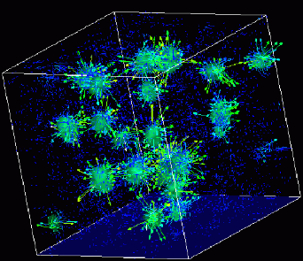

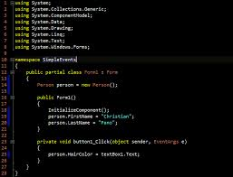
Advanced
Scientific Computing
(SciComp 201)
Session 12
Feuerstein's Stencils

Slide 2
Session Goals
Understand the original intent of the Reuven Feuerstein Instrumental Enrichment program
Learn the rules of the Representative Stencil Design Test (RSDT)
Analyze and Characterize the core Stencils
Complete a subset of the RSDT
Consider the challenges in teaching and programming an RSDT implementation
Appreciate an emerging application of RSDT in diagnosing cognitive impairment

Slide 3
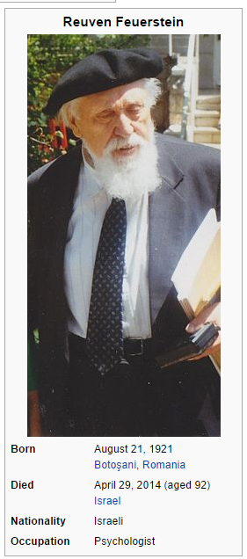
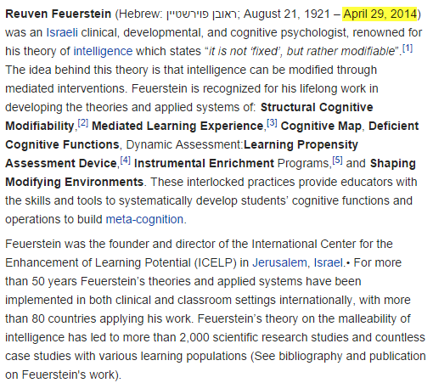
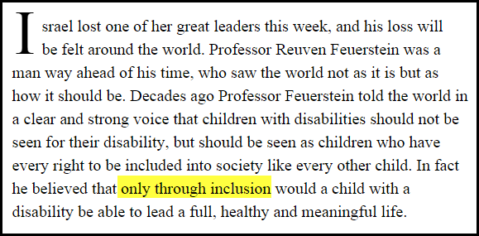
Feuerstein’s Program

Slide 4
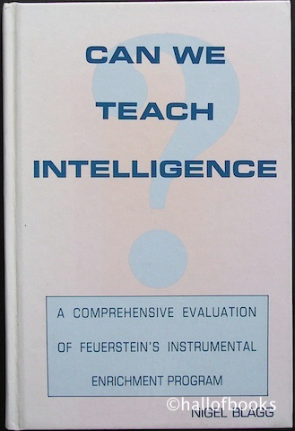
Feuerstein’s Program
In the 1950’s, Feuerstein posed three main revolutionary questions:
What if, instead of measuring a child’s acquired knowledge and intellectual skills, the ability to learn was evaluated first?
What if intelligence was not a fixed attribute, something that can only be “measured”?
What if intelligence could be taught and intelligence was only the ability to learn?

Slide 5
Feuerstein’s Program
What cognitive abilities are required to learn?
Comparison & Categorization
Permutation & Logical Multiplication
Differentiation & Segregation
Analogic & Syllogistic (Deductive) Reasoning
Transformation & Internal Representation
Can mental exercises be developed to build these specific skills and therefore increase intelligence?
The Stencils test requires all of these skills

Slide 6
Feuerstein’s Program
Feuerstein’s Instrumental Enrichment (FIE) is a cognitive intervention program that can be used both individually and in a classroom framework
Feuerstein developed 14 pencil and paper tasks (known as tools or instruments), with increasing difficulty and which are independent of any context, as none of these tasks require any specific language or math skill
These context free tasks are designed to be used by trained educators to increase cognitive function in students and to help students build habits for effective and efficient thinking

Slide 7
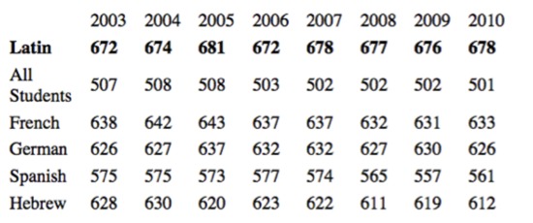
Feuerstein’s Program
Two decades of research working with thousands of participants (of all ages and mental capacities) who regularly used FIE instruments did show a small increase in standard school tests and general I.Q. tests
However, these increases in “IQ” were NOT statistically significant. Correlation does not imply causation!

Slide 8
Feuerstein’s Program
However, research showed a very strong correlation in adolescent children between a low score on the Instrument tasks and significant cognitive difficulties in later school years
Hence the Instruments became part of a Learning Assessment Potential Device (LPAD) to diagnose children who may have special needs
One of the instruments with the highest correlation between excellence in LPAD performance and future academic success was the Representative Stencil Design Test (RSDT)

Slide 9

Video

Slide 10
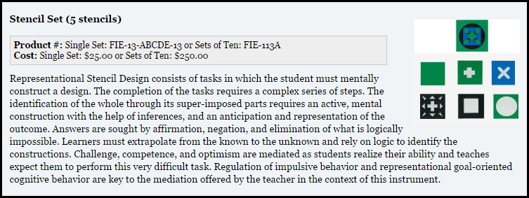
Feuerstein’s Program

Slide 11
STENCILS
Participants are given only a top-down “view” of a stack of varying height. There are no hints about what stencils make up the stack
A stack is built by systematically layering one stencil on top of another to create a pile
Participant must identify in order the number of each stencil used to build the stack, starting from the bottom stencil and working towards the top stencil
Ultimately the various shapes and/or colors of the visible stencils in the stack must exactly match the given top-level view

Slide 12
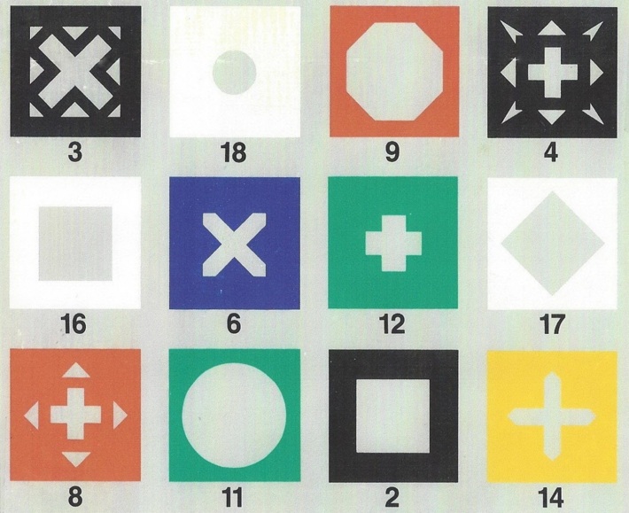
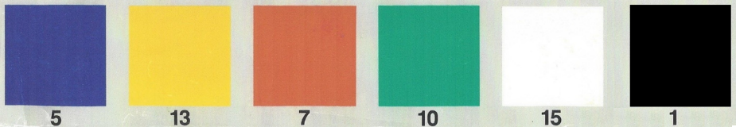

Slide 13
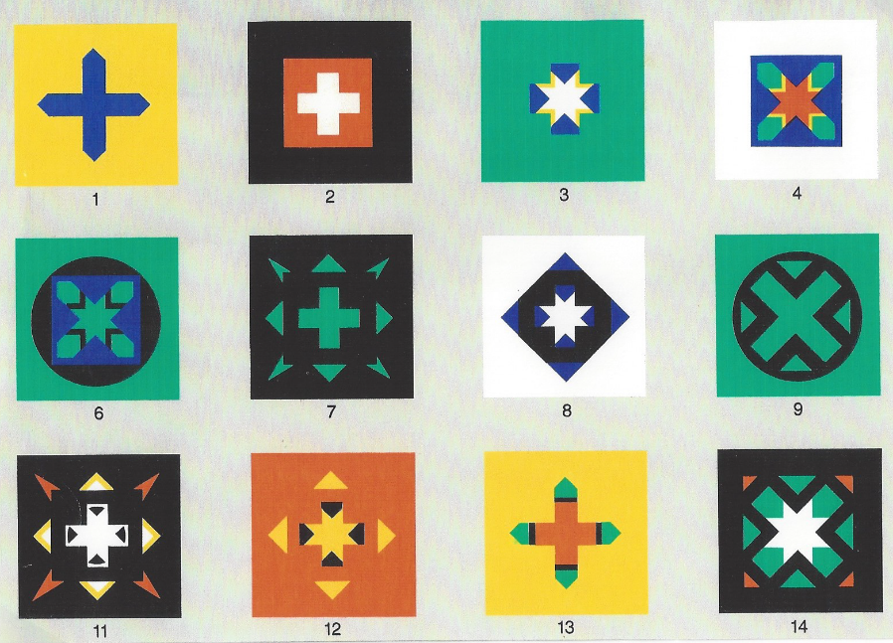

Slide 14
STENCILS
A stack is not valid if any stencil is completely hidden by another stencil higher in the pile
Every test stack has one and only one solution
Participants are not allowed to cut out the stencils so as to physically stack them – the stacking process must be done mentally
Feuerstein provided over 80 striking & unique test stacks in this instrument that vary in stack height and complexity
There are more than 1,000 valid stacks!

Slide 15
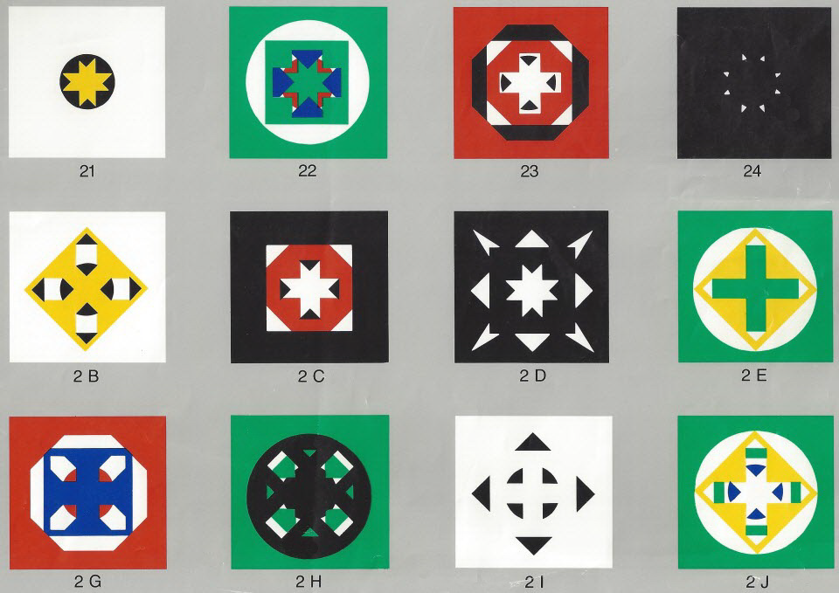

Slide 16
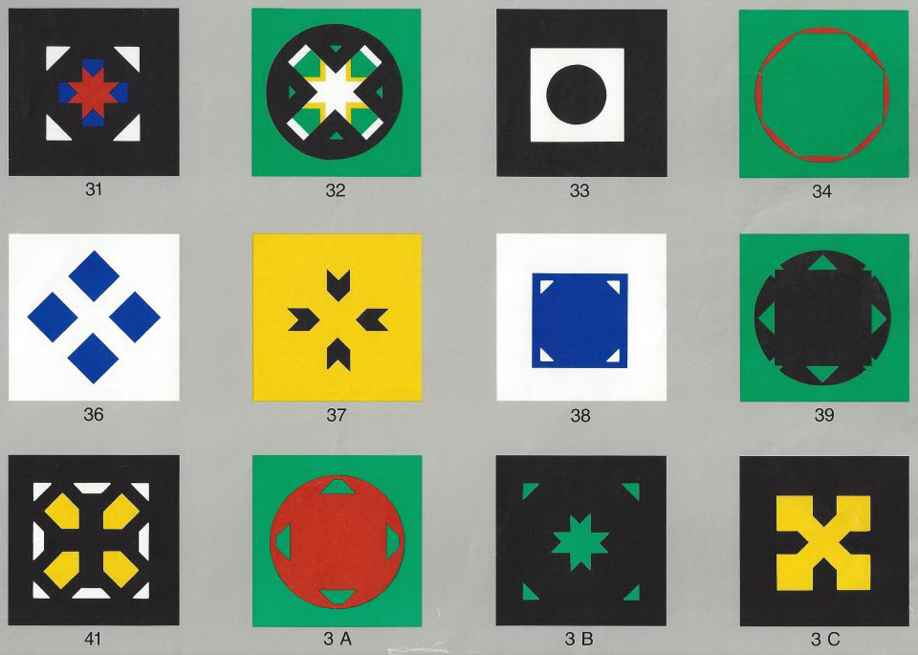

Slide 17
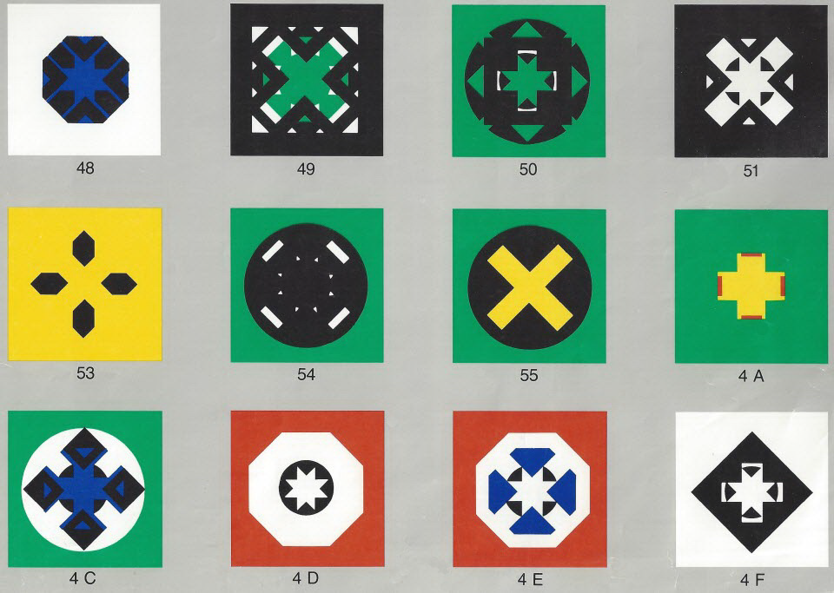

Slide 18
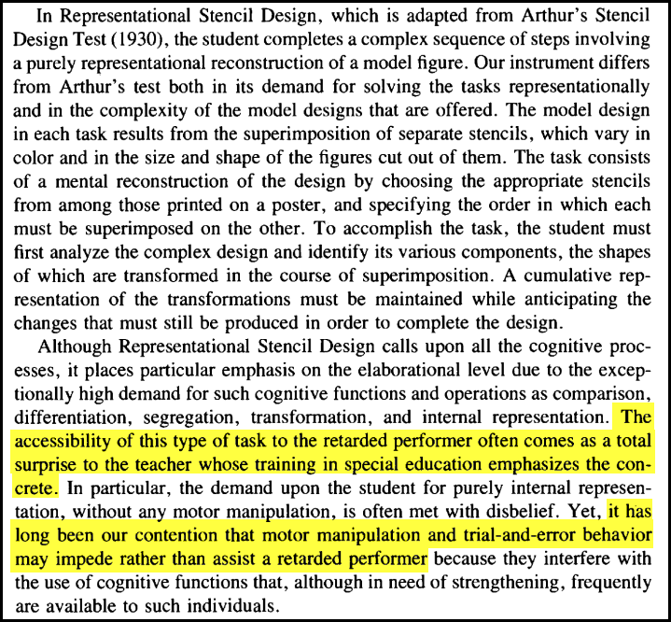

Slide 19
STENCILS
The RSDT is considered one of the hardest of the 14 instruments designed by Feuerstein
Successful completion of all 80 tests requires simultaneously harnessing numerous cognitive abilities:
Recall (shape, color, and number)
Categorization & Differentiation
Three Dimensional Ordering & Visualization
Deduction & Transformation
These skills are widely regarded as the most crucial for learning

Slide 20
Challenges with teaching STENCILS
How do you show participants what their incorrect guess for a test stencil stack would actually look like?
How can children devise new test stacks to challenge each other?
If two children are given the same randomized set of test stacks at the same time, can we time their successful completion to compare their abilities?
Can we chart their completion rate and error rate over time to measure changes in their cognitive ability?

Slide 21
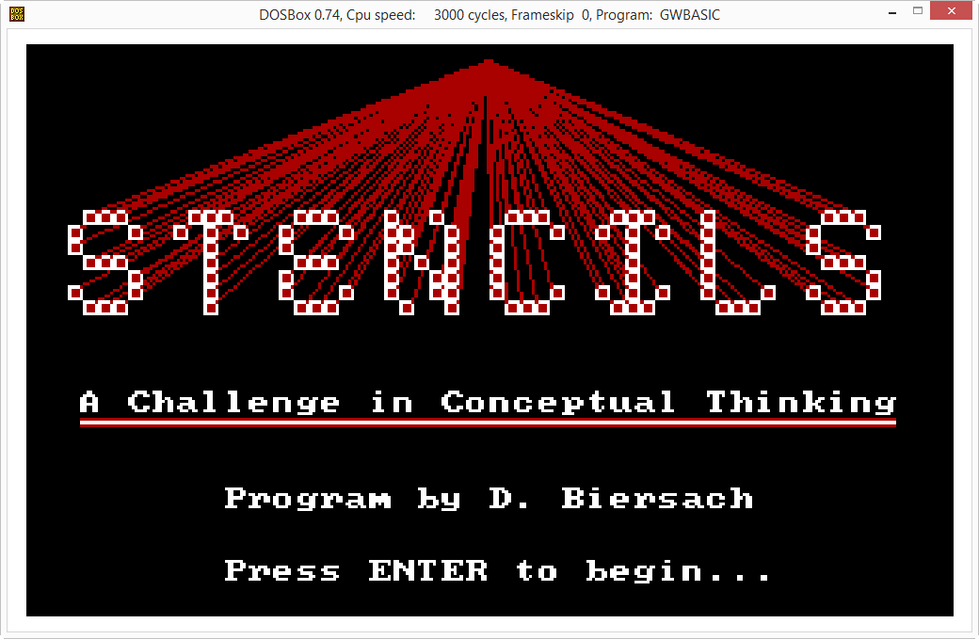

Slide 22
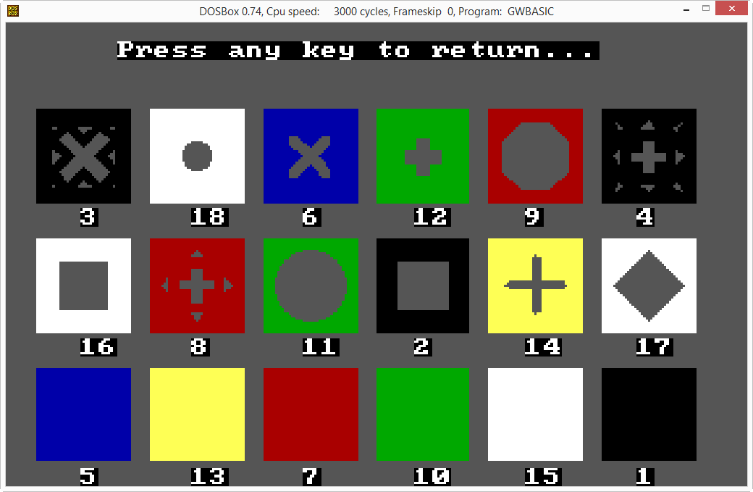

Slide 23
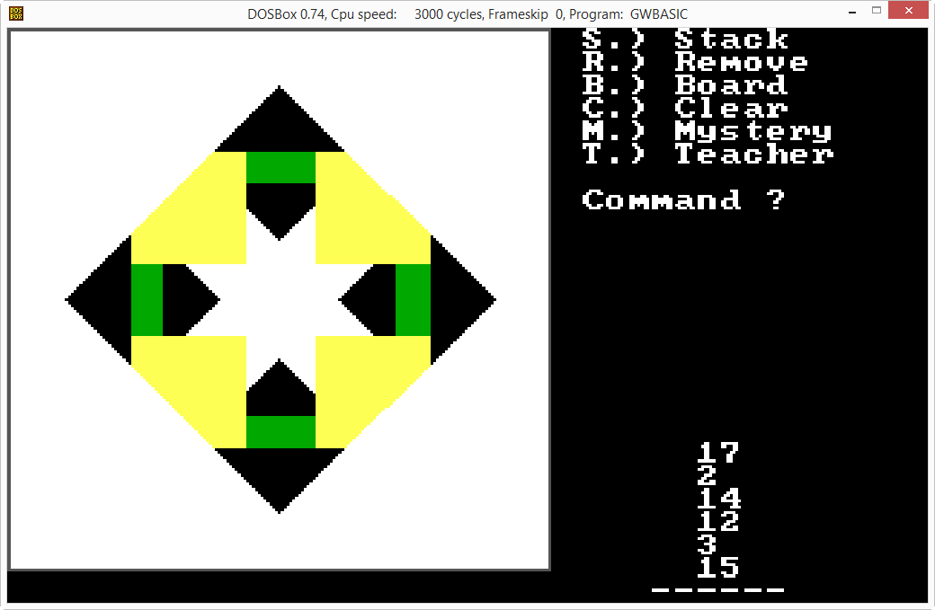

Slide 24
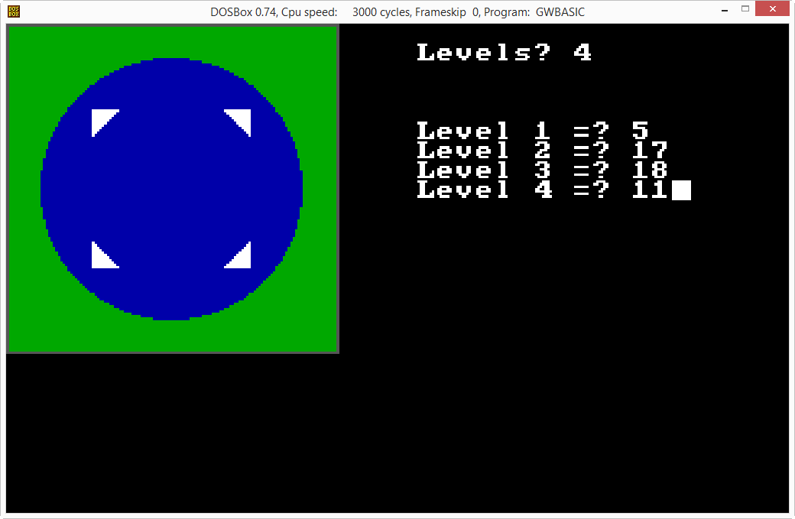

Slide 25
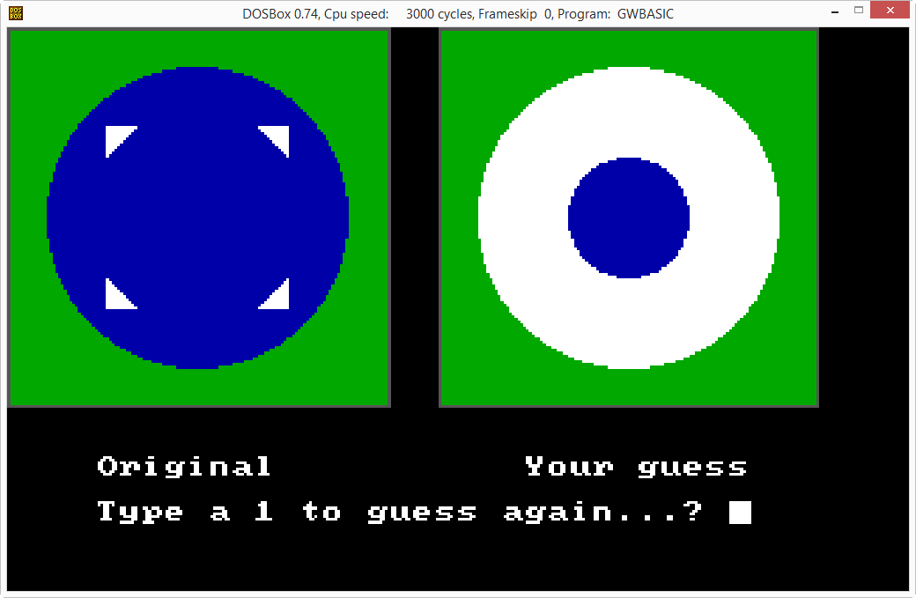

Slide 26
STENCILS
What makes some test stacks harder to visualize than others? Do monochrome stencil stacks appear to be more complex to humans than multi-colored stacks?
What is the maximum height of a valid stack? How many unique “max height” stacks can be constructed?
Does gender and/or age play in role in RSDT success?
What if instead of testing children, the RSDT was given to the aging population to test for cognitive impairment?
Could the Feuerstein’s RSDT be used to identify potential early onset Alzheimer’s?

Slide 27
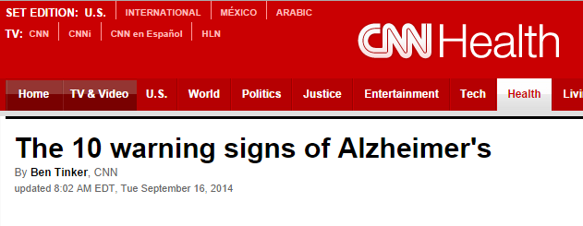
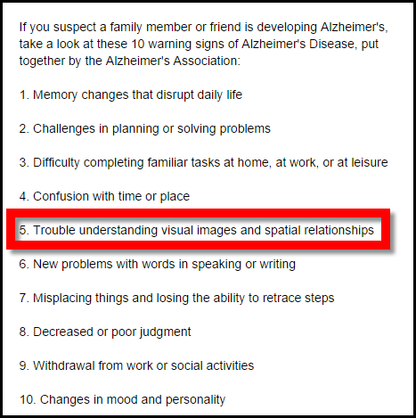

Slide 28
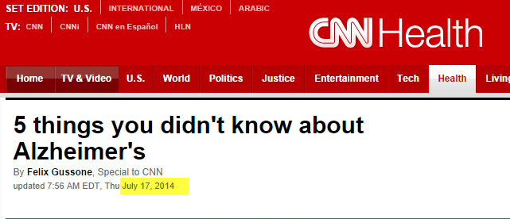
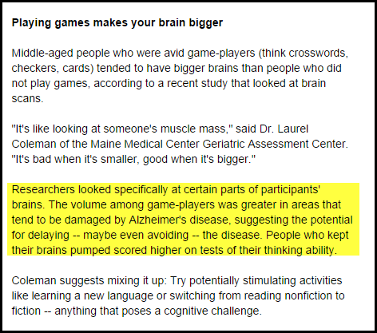


Slide 29
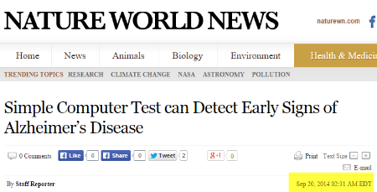
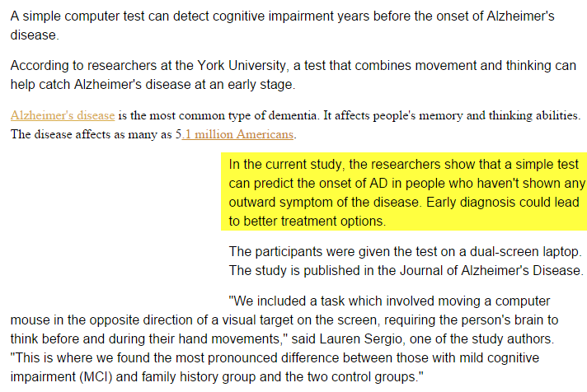

Slide 30
STENCILS
Can a touch (e.g. iPad) tablet version of stencils be designed, but still require users to stack stencils by stencil number? (i.e. no drag-n-drop)
How could a study model be devised to correlate performance on the RSDT with onset of AD? Could this be an app in the cloud to share anonymous results?
Extending the RSDT, what if adjacent stencils could have their colors blend where they overlap?
R + G = YELLOW B + YELLOW = GREEN
R + B = MAGENTA B + G = CYAN
R + B + G = WHITE

Slide 31


Slide 32
Lab
Identify the correct stencil stacking order in each of the 36 sample tests in your packet
Your answer sequences should be listed left to right, moving up from the bottom stencil to the top stencil on the stack, using hyphens to separate the stencil numbers
Stencil Test #1: 5-14
Stencil Test #4: 7-14-12-6-16
Use my 1987 BASIC app if you need to try out ideas
Compile a list of observations of the core stencil templates – what do you see?

Slide 33
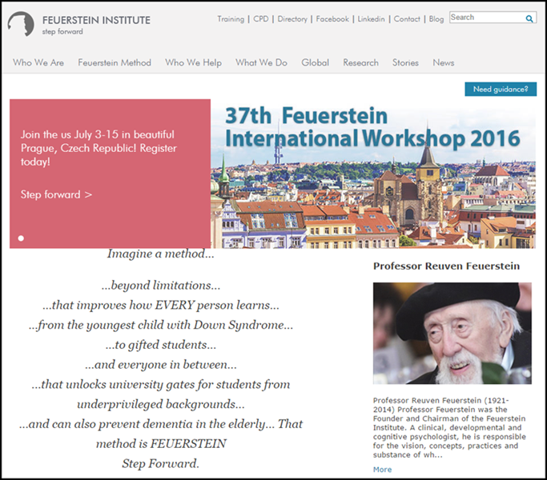
http://feuerstein-global.org

Slide 34
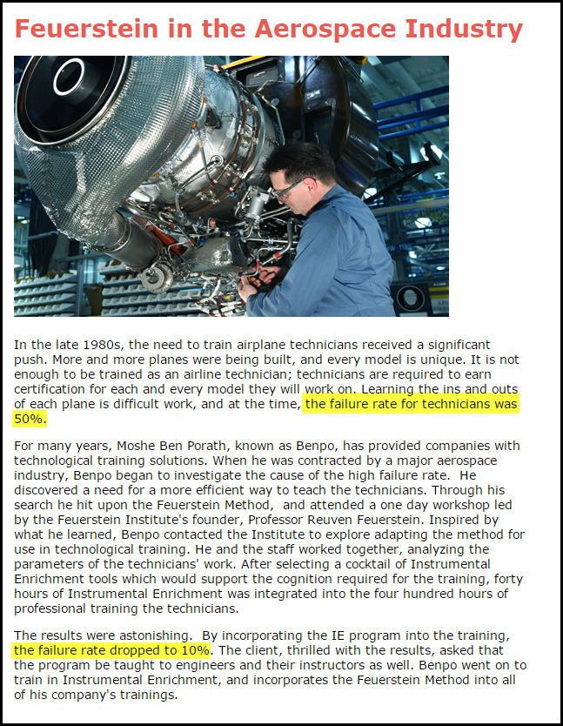

Slide 35
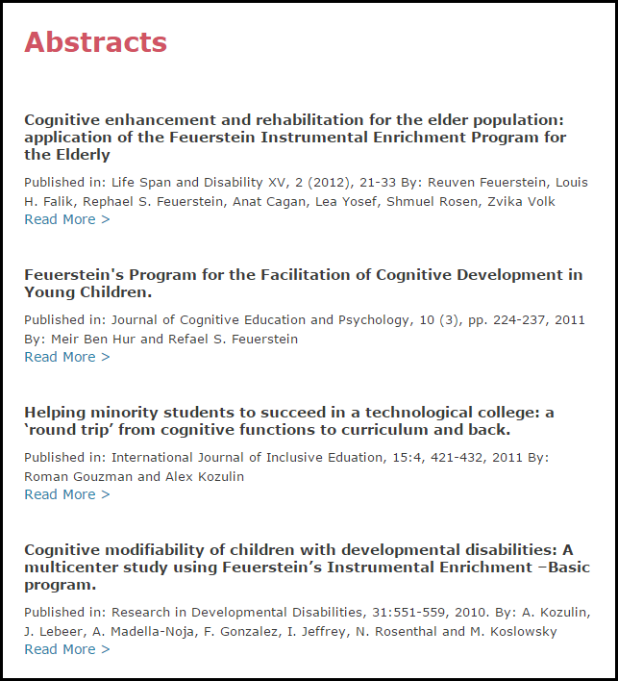

Slide 36
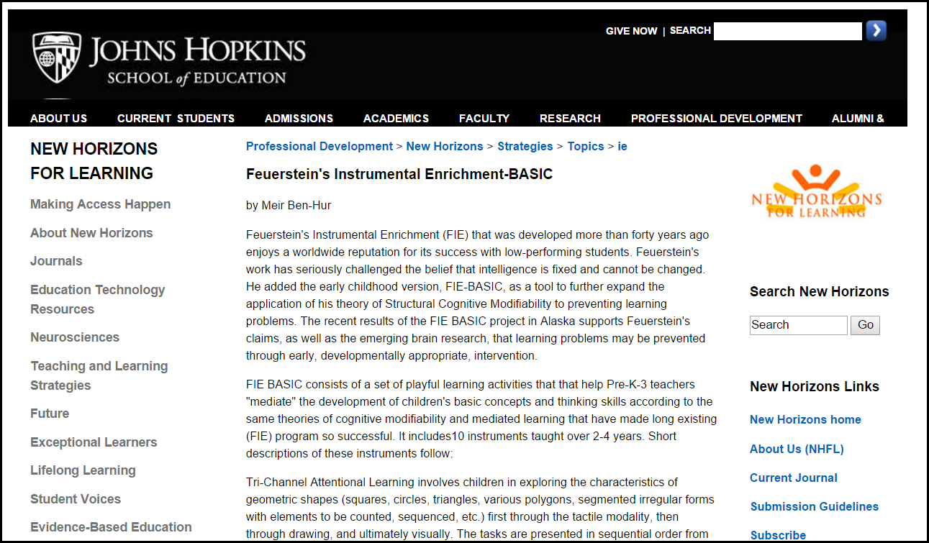

Slide 37
Now you know…
Reuven Feuerstein’s IE program was designed to systematically improve intelligence – however it did not achieve that goal
However, IE became an outstanding tool (LPAD) for diagnosing potential learning impairment in children – as early as 2nd grade!
LPAD statistics also demonstrate that children who achieve high RSDT scores have significant potential for future success in self-directed research

Slide 38
Now you know…
New evidence suggests that RDST may also be a reliable indicator of emerging mild cognitive impairment (MCI) in the elderly, so that early intervention may be more effective
The use of tablet (hand-held touch screen) computers may enable researchers to conduct larger clinical trials
It is believed that, with daily RDST practice, older adults can slow down the (currently) inevitable loss of higher-order mental capabilities
What can you contribute to this science?

